Slide 1
INDICATORS
Name of the instructor: U.Nithya M.Sc.,M.Phil.,

Slide 2
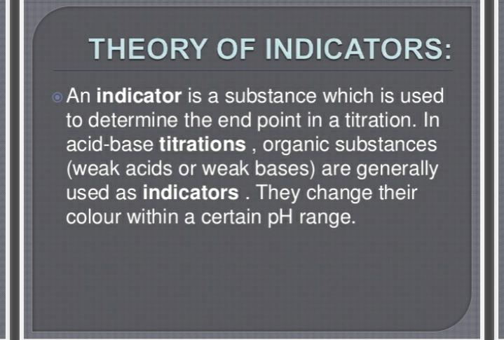

Slide 3
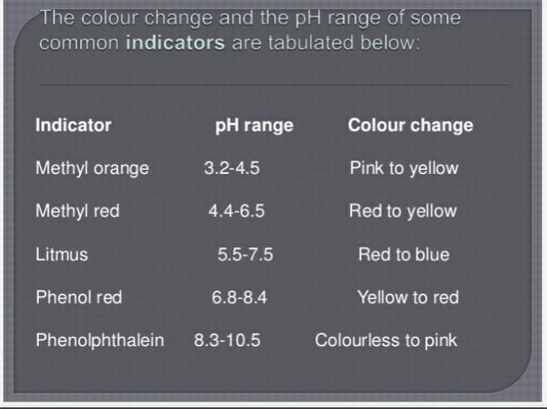

Slide 4
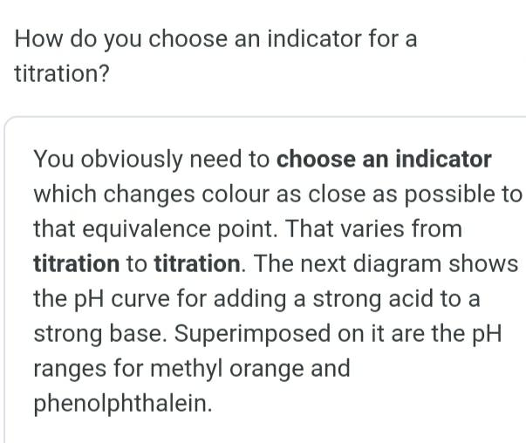

Slide 5
TYPES OF INDICATORS:
• Acid –Base indicators
• Mixed indicators
• Fluorescent indicators

Slide 6
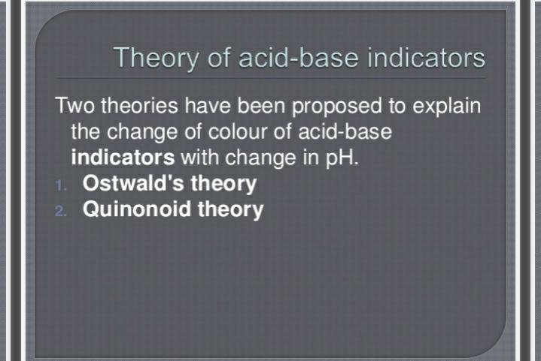

Slide 7
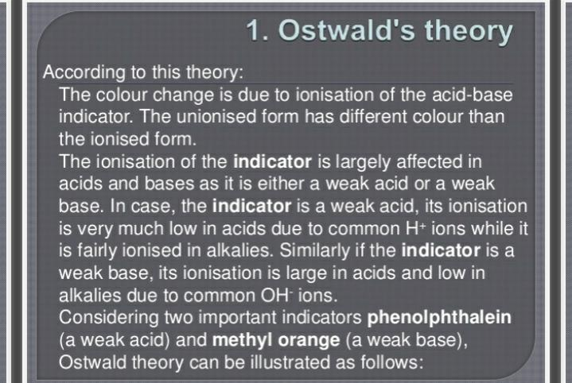

Slide 8
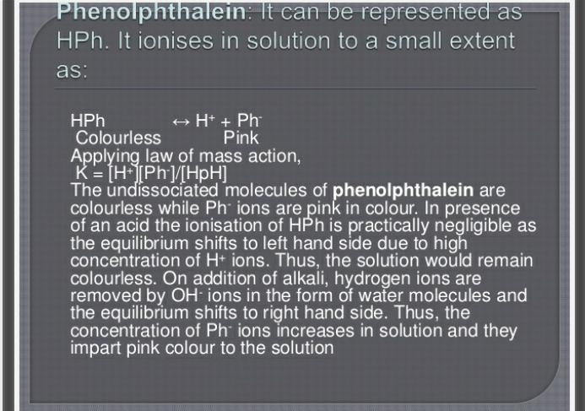

Slide 9
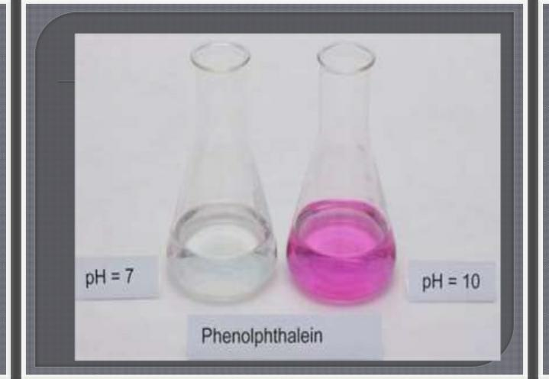

Slide 10
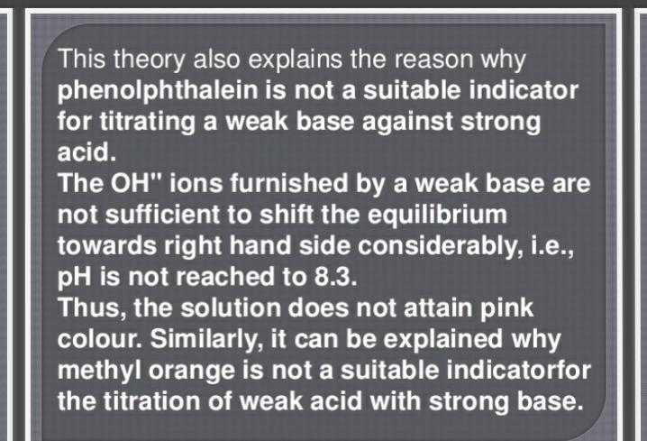

Slide 11
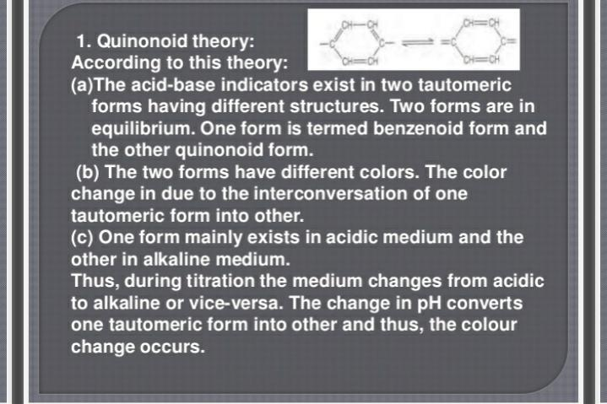

Slide 12
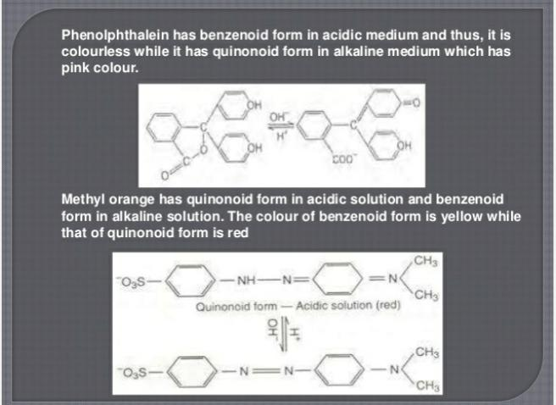

Slide 13
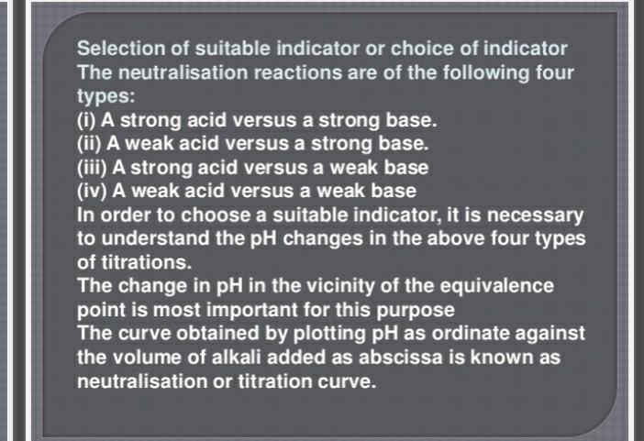

Slide 14
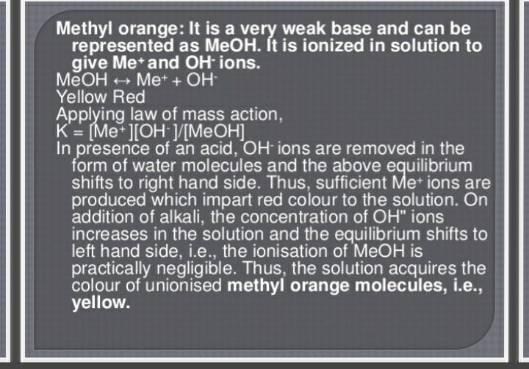

Slide 15
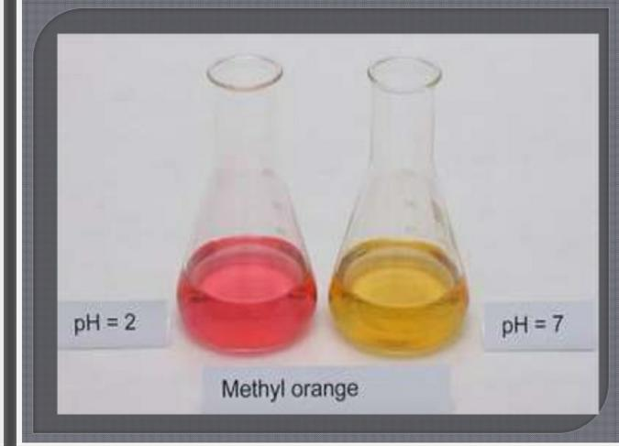

Slide 16
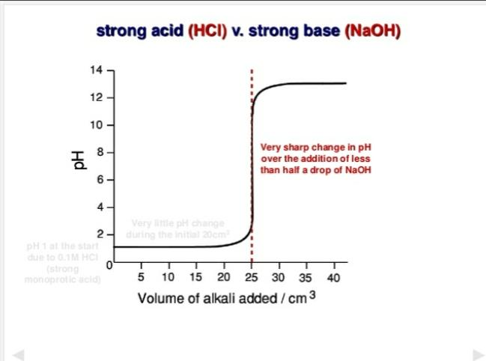

Slide 17
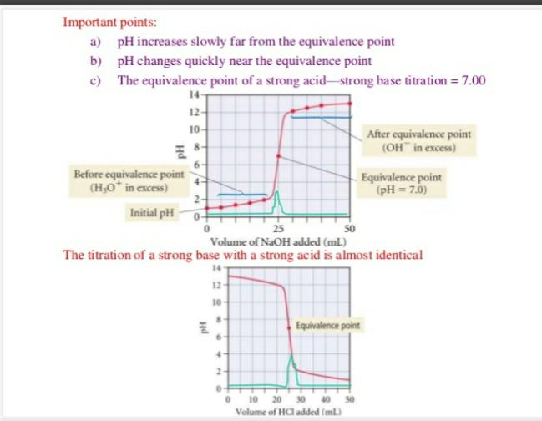

Slide 18
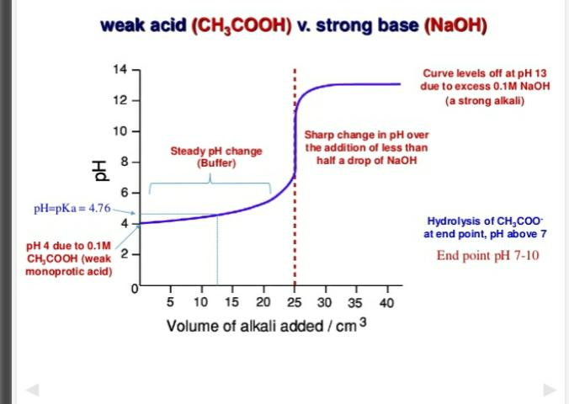

Slide 19
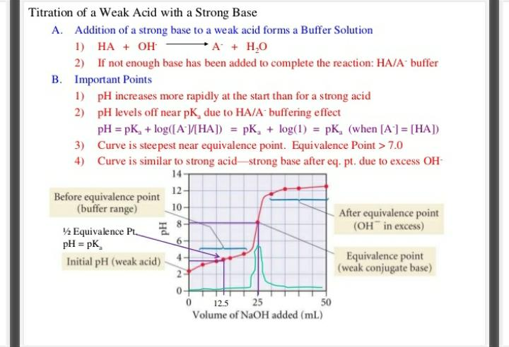

Slide 20
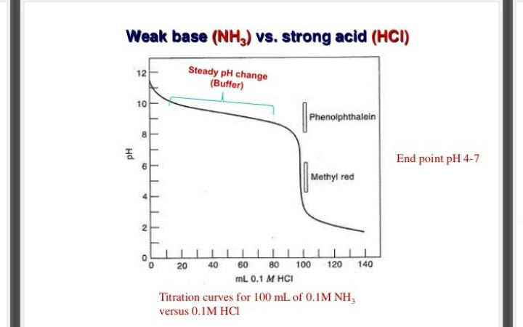

Slide 21
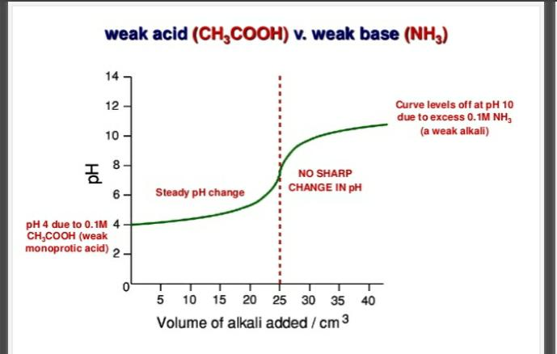

Slide 22
2. MIXED INDICATORS:
They are mixtures of usual acid bases indicators and orange dyes. They are used to increase the sharpness of the visible end point.
The added dye is not affected by P^{H}. It blocks out certain wavelengths of light common to the colours of indicators before and after the endpoint. So,that there is a marked difference between them.
Eg:
Methyl Purple. It is mixture of methyl red and an inert blue dye. It has a very pronounced colour change.
Furthur the colour change occurs over a very pronounced colour change occurs over a very narrow P^{H}range.

Slide 23
3. FLUORESCENT INDICATORS:
They are substances which fluorescein ultraviolet light and change colour or have their fluorescence quenched with change in P^{H}.
Ex :
fluorescein and eosin(tetrabromo fluorescein)
Explanation:
The intensity and colour of the fluorescence of many substances depend upon the P^{H} of the solution.
Indeed some substances as so sensitive to P^{h}indicators.These are termed fluorescent or luminescent indicators.
Fluorescent indicators are used in acid-base titrations.
These indicators can be employed in the titration of coloured solutions in which the coloue changes of the usual indicators would be masked. Titrations are performed in a silica flask.

Slide 24
Eosin and florescein are frequently emplyed as adsorption indicators.
Fluorescein is used in the P^{H} range 4-6,when the colour change is from colourless to green.
Eosin changes its colour in the P^{h}range 3-4 from colourless to green.

Slide 25
THANK YOU

